Slide 1
Disaster Site Worker
University of Texas at Arlington
OSHA Education Center
15 Hour Outreach

Slide 2
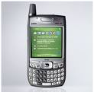
Administration
Emergency exits
Restrooms
Breaks
Phones
Safety Share

Slide 3
Disaster Site Worker
Introductions
WHO you are…
WHERE you are from…
WHY you are here…
WHAT are your expectations?

Slide 4
Introductions
Select spokesperson
Name your group
Form Groups

Slide 6
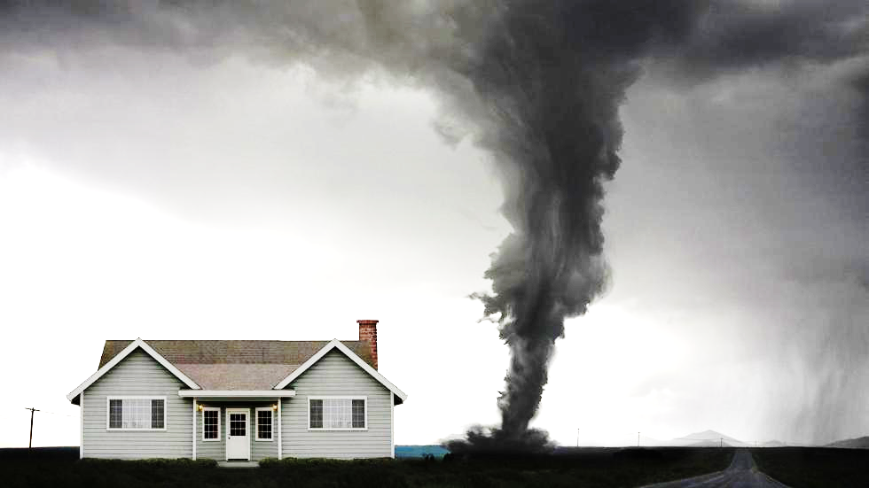
Dashboard
COURSE
OVERVIEW

